Slide 1

Arc Length and Surfaces of Revolution
7.4
Copyright © Cengage Learning. All rights reserved.

Slide 2
Objectives
Find the arc length of a smooth curve.
Find the area of a surface of revolution.

Slide 3
Arc Length

Slide 4
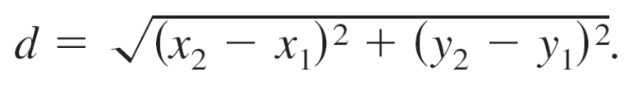
Arc Length
Definite integrals are use to find the arc lengths of curves and the areas of surfaces of revolution.
In either case, an arc (a segment of a curve) is approximated by straight line segments whose lengths are given by the familiar Distance Formula
A rectifiable curve is one that has a finite arc length.

Slide 5
Arc Length
You will see that a sufficient condition for the graph of a function f to be rectifiable between (a, f(a)) and (b, f(b)) is that f' be continuous on [a, b].
Such a function is continuously differentiable on [a, b], and its graph on the interval [a, b] is a smooth curve.

Slide 6
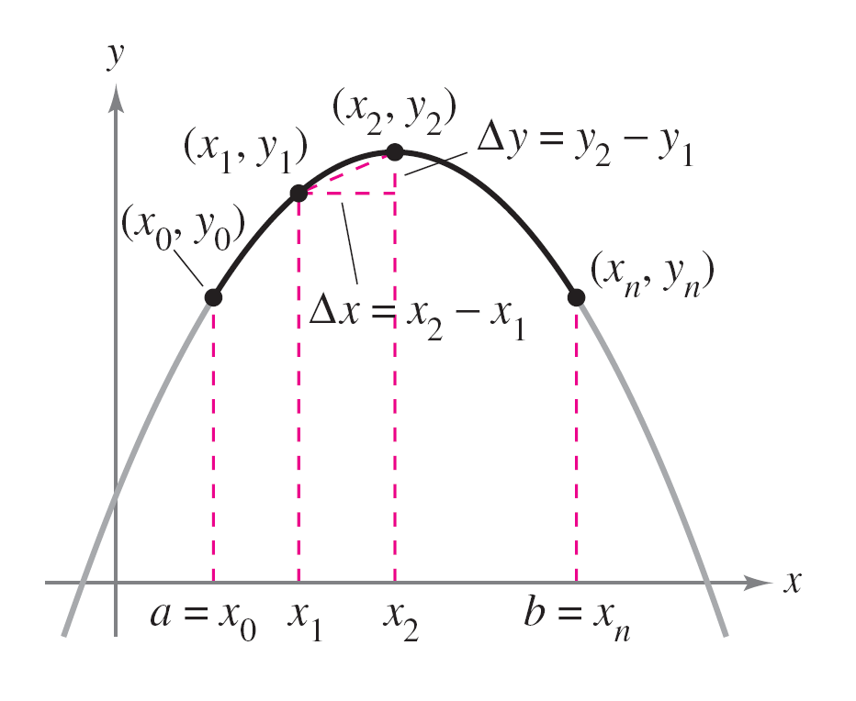
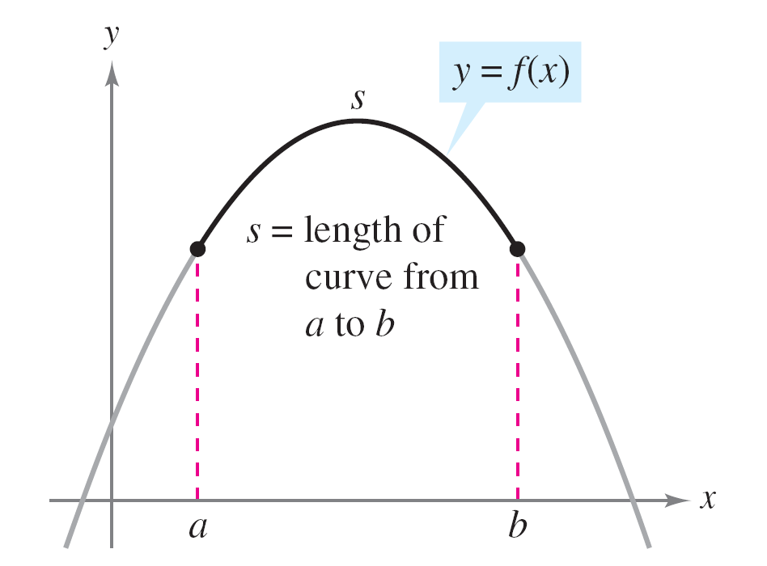
Arc Length
Consider a function y = f(x) that is continuously differentiable on the interval [a, b]. You can approximate the graph of f by n line segments whose endpoints are determined by the partition a = x₀ < x₁ < x₂ < … < x_{n} = b as shown in Figure 7.37.
Figure 7.37

Slide 7
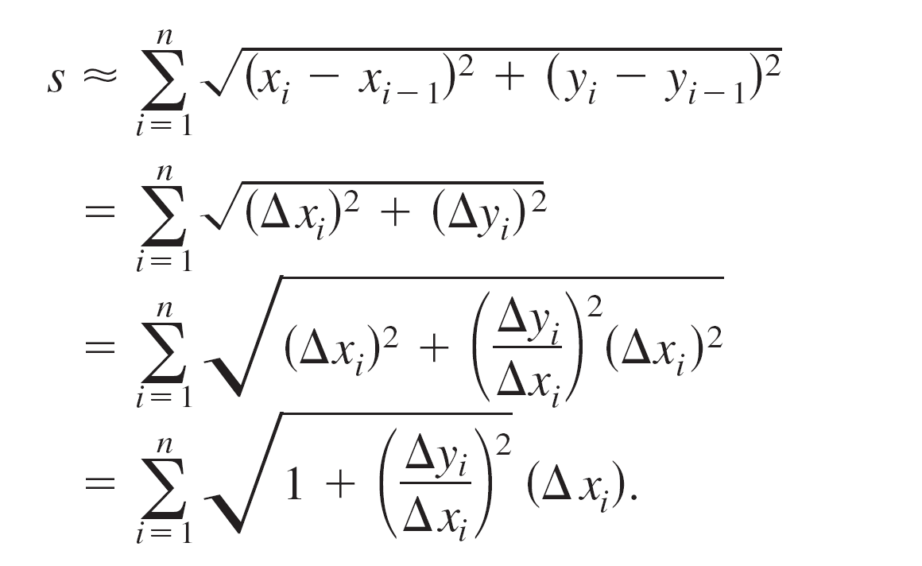

Arc Length
By letting Δx_{i} = x_{i} – x_{i – 1} and Δy_{i} = y_{i} – y_{i – 1}, you can
approximate the length of the graph by
This approximation appears to become better and better as

Slide 8
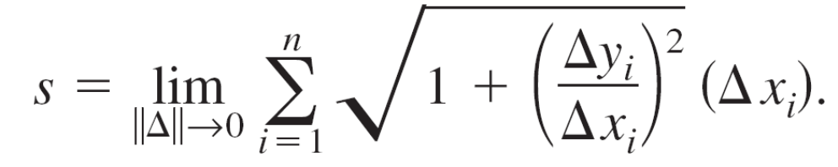
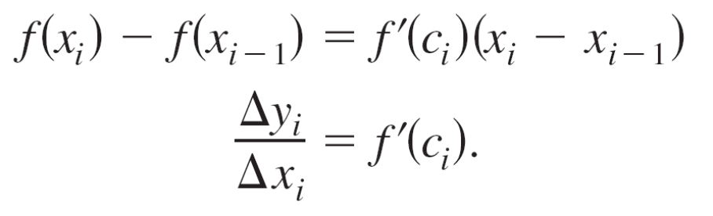
Arc Length
So, the length of the graph is
Because f'(x) exists for each x in (x_{i – 1}, x_{i} ), the Mean Value Theorem guarantees the existence of c_{i} in (x_{i – 1}, x_{i} ) such that

Slide 9

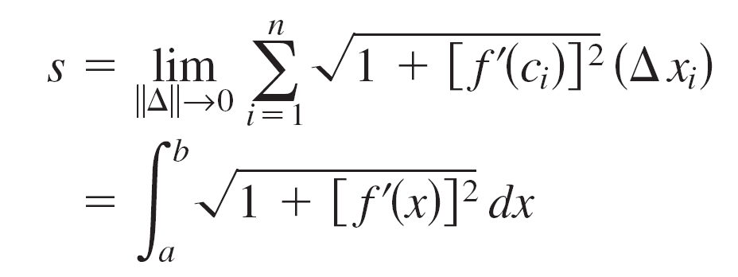
Arc Length
Because f' is continuous on [a, b], it follows that
is also continuous (and therefore integrable) on [a, b], which implies that
where s is called the arc length of f between a and b.

Slide 10
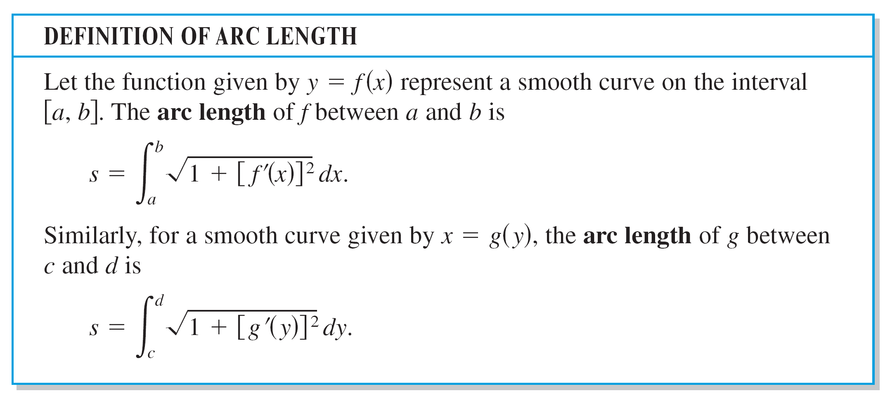
Arc Length

Slide 11
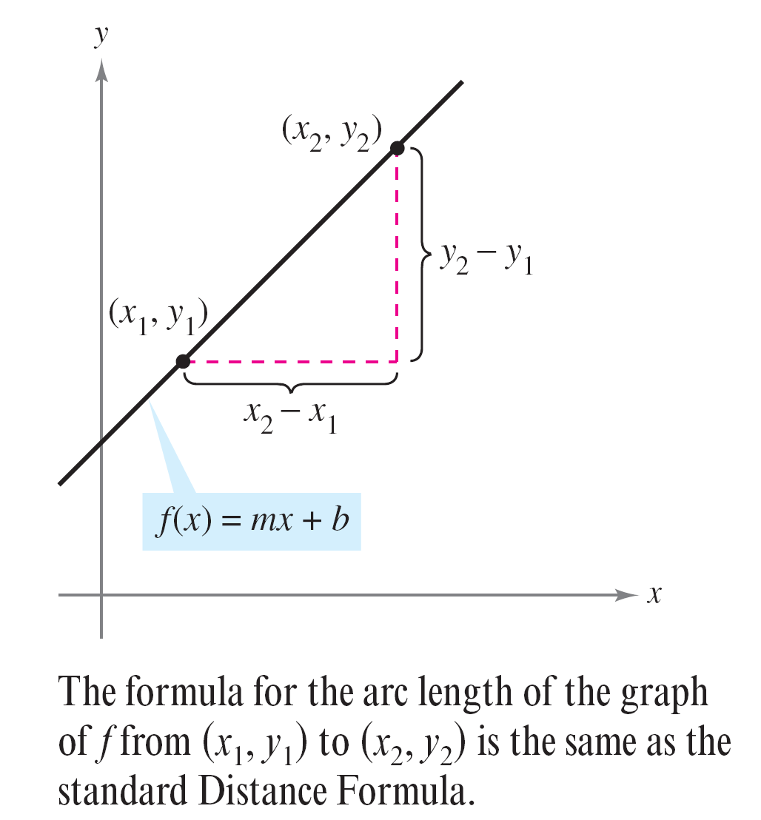
Example 1 – The Length of a Line Segment
Find the arc length from (x₁, y₁) to (x₂, y₂) on the graph of f(x) = mx + b, as shown in Figure 7.38.
Figure 7.38

Slide 12
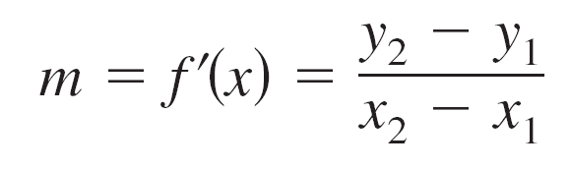
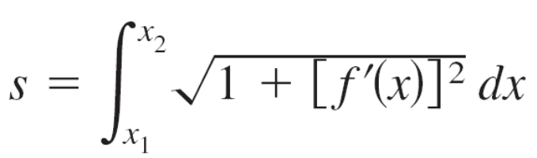

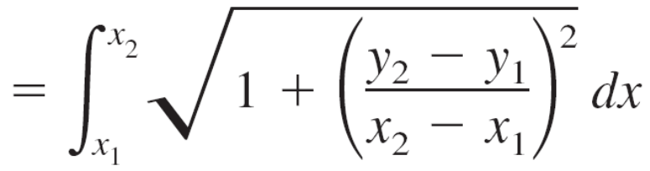
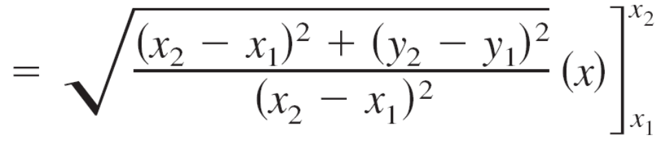

Example 1 – Solution
Because
it follows that

Slide 13
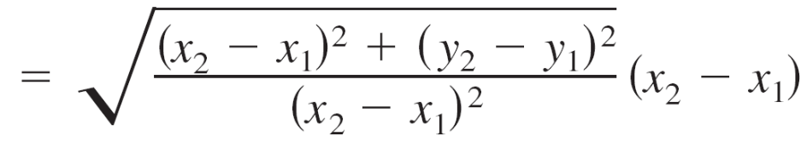
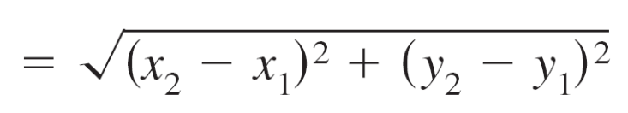
Example 1 – Solution
cont’d
which is the formula for the distance between two points
in the plane.

Slide 14
Area of a Surface of Revolution

Slide 15
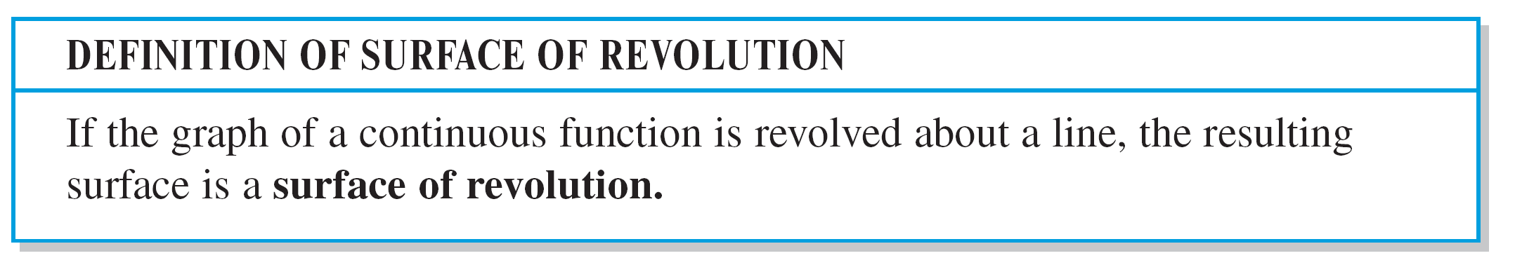
Area of a Surface of Revolution
The area of a surface of revolution is derived from the
formula for the lateral surface area of the frustum of a
right circular cone.

Slide 16
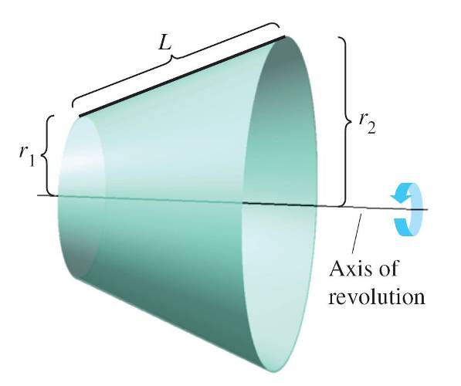
Area of a Surface of Revolution
Consider the line segment in Figure 7.43, where L is the length of the line segment, r₁ is the radius at the left end
of the line segment, and r₂ is the radius at the right end of the line segment.
Figure 7.43

Slide 17
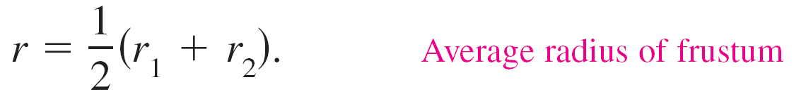
Area of a Surface of Revolution
When the line segment is revolved about its axis of revolution, it forms a frustum of a right circular cone, with
where

Slide 18
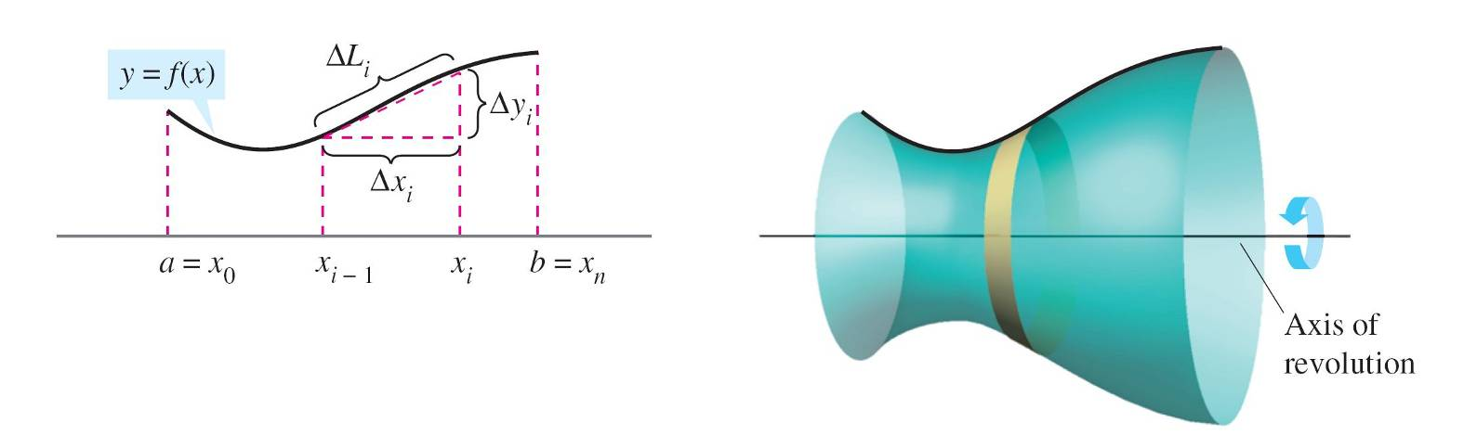
Area of a Surface of Revolution
Suppose the graph of a function f, having a continuous derivative on the interval [a, b], is revolved about the x-axis to form a surface of revolution, as shown in Figure 7.44.
Figure 7.44.

Slide 19

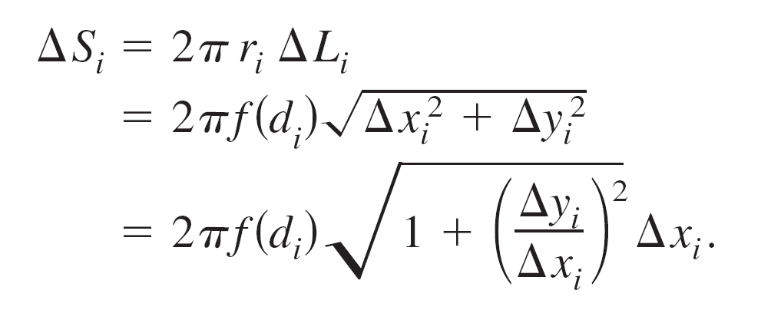
Area of a Surface of Revolution
Let Δ be a partition of [a, b], with subintervals of width Δx_{i}. Then the line segment of length generates a frustum of a cone.
Let r_{i} be the average radius of this frustum.
By the Intermediate Value Theorem, a point d_{i} exists
(in the ith subinterval) such that r_{i} = f(d_{i}).
The lateral surface area ΔS_{i} of the frustum is

Slide 20
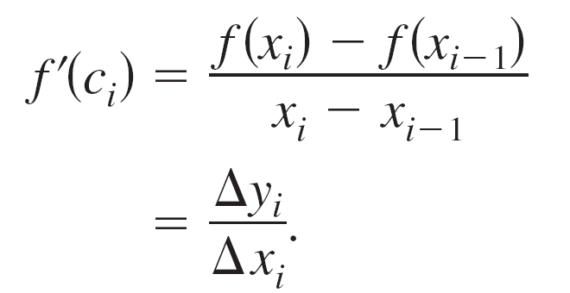
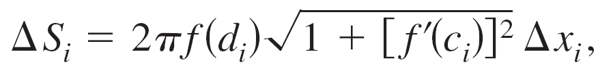
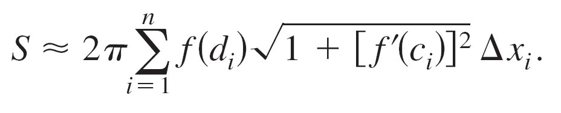
Area of a Surface of Revolution
By the Mean Value Theorem, a point c_{i} exists in (x_{i – 1}, x_{i} ) such that
So, and the total surface area
can be approximated by

Slide 21
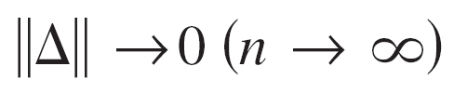
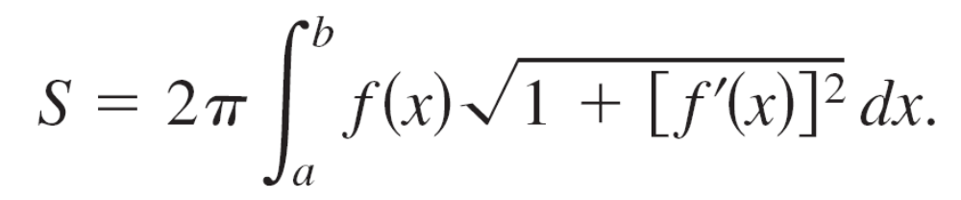
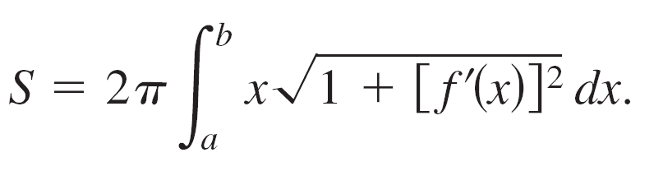
Area of a Surface of Revolution
It can be shown that the limit of the right side as
is
In a similar manner, if the graph of f is revolved about the y-axis, then S is

Slide 22
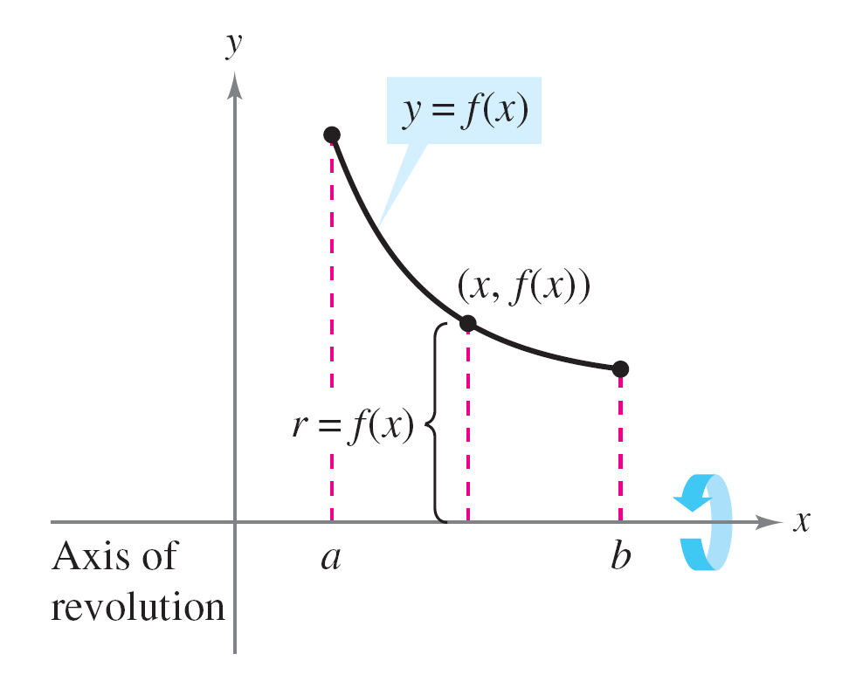
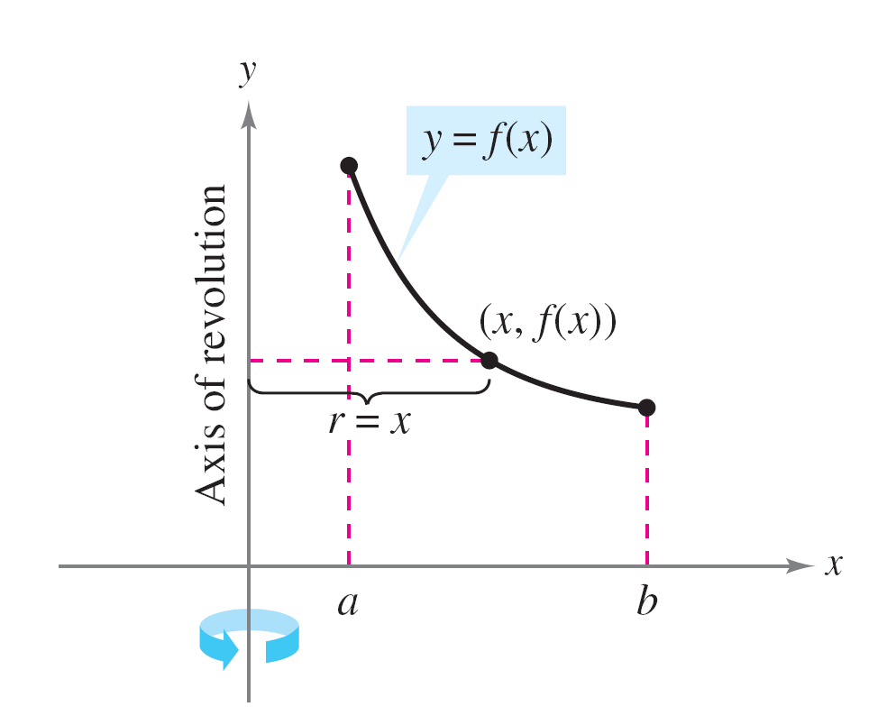
Area of a Surface of Revolution
In these two formulas for S, you can regard the products
2πf(x) and 2πx as the circumferences of the circles traced
by a point (x, y) on the graph of f as it is revolved about the
x-axis and the y-axis (Figure 7.45). In one case the radius
is r = f(x), and in the other case the radius is r = x.
Figure 7.45

Slide 23
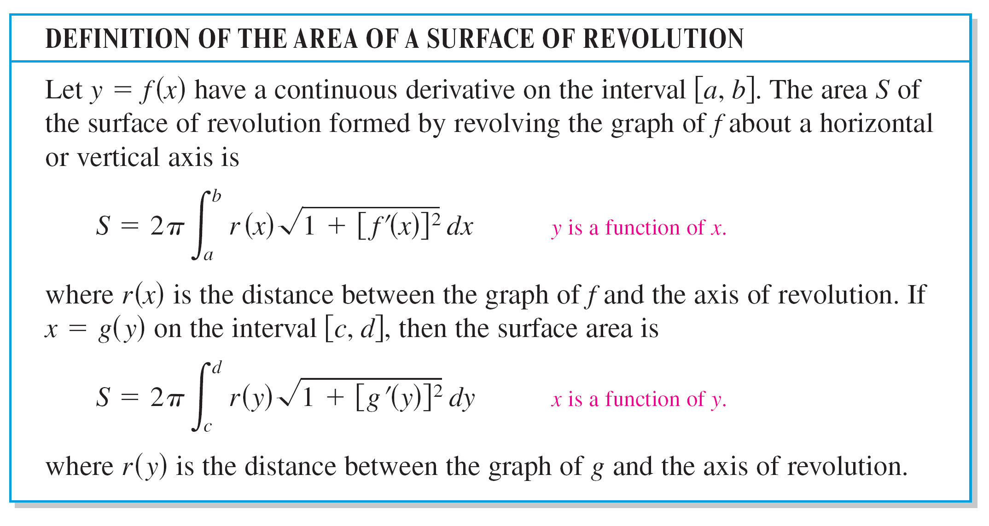
Area of a Surface of Revolution

Slide 24
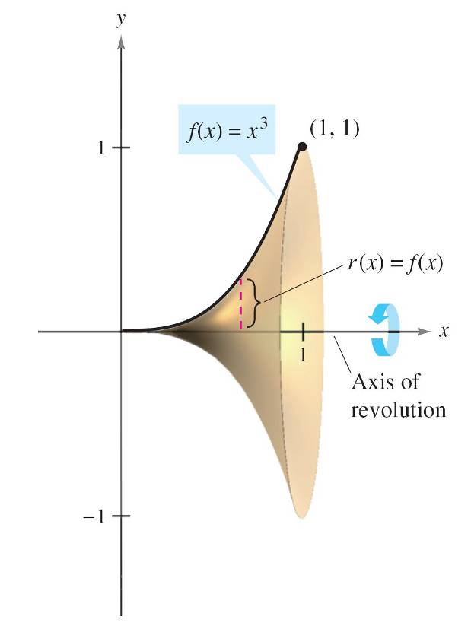
Example 6 – The Area of a Surface of Revolution
Find the area of the surface formed by revolving the graph
of f(x) = x³ on the interval [0, 1] about the x-axis, as shown
in Figure 7.46.
Figure 7.46

Slide 25
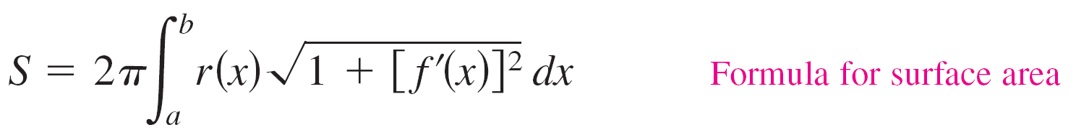
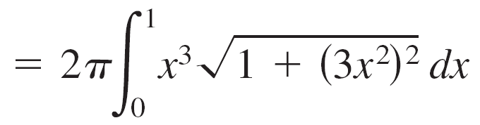
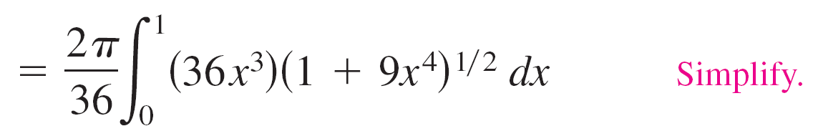
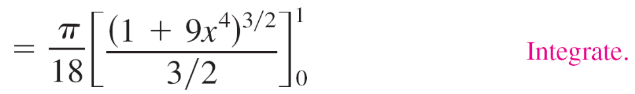
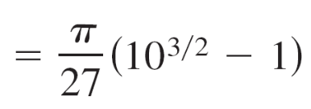

Example 6 – Solution
The distance between the x-axis and the graph of f is
r(x) = f(x), and because f'(x) = 3x², the surface area is

